Slide 1
THE ERYTHEMATOUS SCROTUM: A CASE OF RECURRENT IDIOPATHIC SCROTAL EDEMA
Andrea Fabiani*, Maria Pia Pavia°, Emanuele Principi*, Lucilla Servi*
*Urology Unit, Surgical Dpt, ASUR MARCHE Area Vasta 3, Macerata (Italy)
° Resident, Department of Urology, Marche Polythecnic University, Ancona (Italy)

Slide 2
A Nine-year-old boy was referred from the Emergency Department to our Urologic Section for a six hours hystory of bilateral scrotal dyscomfort, swelling and redness. The patient not complain about accompanying symptoms. Pathological anamnesis received by the mother was silent. Scrotum was enlarged, not painful, the skin red and tender to palpation
Notes:
RIPORTIAMO IL CASO DI UN PAZIENTE DI 9 ANNI ACCOMPAGNATO DALLA MADRE IN PRONTO SOCCORSO IN SEGUITO ALLA IMPROVVISA INSORGENZA DI ARROSSAMENTO DELLO SCROTO, RIGONFIAMENTO DELLO STESSO E RIFERITO SENSO DI FASTIDIO DA PARTE DEL PICCOLO PAZIENTE…

Slide 3
TWIST score
Testicular swelling 2 points
Presence of hard testicle 2 points
Absence of cremasteric reflex 1 point
presence of high riding testicle 1 point
presence of nausea/vomiting 1 point
Notes:
SI PROCEDE ALLA DEFINIZIONE DEL TWIST SCORE, CIOE’ DEL TESTICULAR WORKUP FOR ISCHEMIA AND SUSPECTED TORSION SCORE… UTILE STRUMENTO DI INDIRIZZO “FAST” DELLA VALUTAZIONE DELLO SCROTO ACUTO IN ETA’ PEDIATRICA….

Slide 4
TWIST score*
Testicular swelling 2 points
Presence of hard testicle 2 points
Absence of cremasteric reflex 1 point
presence of high riding testicle 1 point
presence of nausea/vomiting 1 point
* Some advocate for only using TWIST score in pubertal males
High 6-7
No imaging
(consider it only in children at 1-2 Tanner stage)
Immediate surgical exploration
Notes:
LO SCORE TIPICAMENTE INDIVIDUA UNA CLASSE DEFINITA AD ALTO RISCHIO DI TORSIONE DEL FUNICOLO, SE IL PUNTEGGIO E’ TRA 6 E 7….

Slide 5
TWIST score*
Testicular swelling 2 points
Presence of hard testicle 2 points
Absence of cremasteric reflex 1 point
presence of high riding testicle 1 point
presence of nausea/vomiting 1 point
* Some advocate for only using TWIST score in pubertal males
High: 6-7
No imaging
(consider it only in children at 1-2 Tanner stage)
Immediate surgical exploration
Intermediate: 1-5
SCROTAL ultrasound
Consider alternative diagnosis and obtain additional testing as warranted …
Notes:
RISCHIO INTERMEDIO FRA 1 E 5…

Slide 6
TWIST score*
Testicular swelling 2 points
Presence of hard testicle 2 points
Absence of cremasteric reflex 1 point
presence of high riding testicle 1 point
presence of nausea/vomiting 1 point
* Some advocate for only using TWIST score in pubertal males
LOW: 0
Avoid SCROTAL ultrasound…
But consider that Torsion can be deceptive and present atypically… so, we would still have a low threshold for obtaining an ultrasound…
Notes:
NESSUN RISCHIO SE NON SONO SODDISFATTI I CRITERI MENZIONATI, OVVERO: RIGONFIAMENTO DEL TESTICOLO, AUMENTO DI CONSISTENZA DELLO SCROTO, ASSENZA DEL RIFLESSO CREMASTERICO, RISALITA DEL TESTICOLO VERSO L’ALTO, PRESENZA DI NAUSEA O VOMITO

Slide 7
TWIST score*
Testicular swelling 2 points
Presence of hard testicle 2 points
Absence of cremasteric reflex 1 point
presence of high riding testicle 1 point
presence of nausea/vomiting 1 point
* Some advocate for only using TWIST score in pubertal males
TWIST score was 2 points
Notes:
NEL NOSTRO CASO LO SCORE E’ 2…

Slide 8
TWIST score*
Testicular swelling 2 points
Presence of hard testicle 2 points
Absence of cremasteric reflex 1 point
presence of high riding testicle 1 point
presence of nausea/vomiting 1 point
* Some advocate for only using TWIST score in pubertal males
TWIST score was 2 points
Intermediate: 1-5
SCROTAL ultrasound
Consider alternative diagnosis and obtain additional testing as warranted …
Notes:
QUINDI VIENE ESEGUITA UNA VALUTAZIONE ECOGRAFICA…

Slide 9
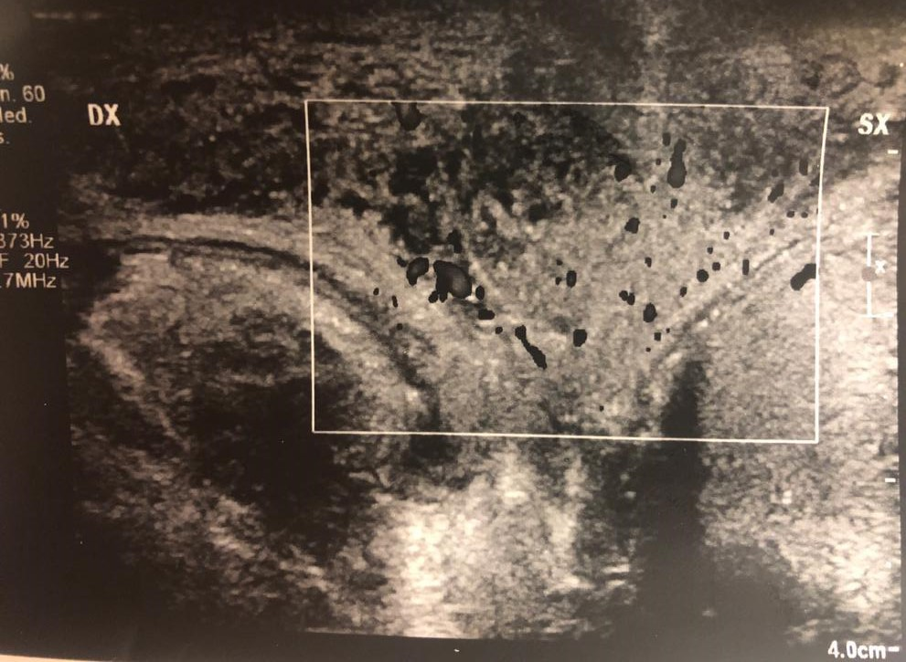
Hyperemic thickened scrotal wall around the testicles, described as the
“fountain sign”.
In transverse color doppler both testis and epydydimis have a normal appearance
Notes:
CON IL RISCONTRO DEL PATOGNOMONICO SEGNO DELLA FONTANELLA… CHE CONSISTE IN UNA ACCENTUAZIONE DELLA TRAMA ECOCOLORDOPPLER A LIVELLO DEL SETTO INTERSCROTALE BEN VISUALIZZATO NELLA SCANSIONE TRASVERSALE.. CIO’ E’ LEGATO A UN ISPESSIMENTO IPEREMICO ED EDEMA DIFFUSO SULLA PARETE SCROTALE E SUL SETTO STESSO

Slide 10
The patient was discharged with anti-inflammatory therapy (Ibrupophene for pediatrics). No notice about clinical evolution was received until one month later. The little patient was again accompained to the Emergency Department because of the new onset of the same symptoms. Clinical and ultrasonographic findigs were the same. In addition, the mother reported that his son had woken up the same morning with swollen lips.
Diagnosis of AISE was done again.
The patient was referred to pediatrics for internal evaluation work-up.
Notes:
LA DIAGNOSI E’ DUNQUE RESA POSSIBILE GRAZIE AL RISCONTRO DI QUESTO INEQUIVOCABILE SEGNO ECOGRAFICO…. SIA AL PRIMO EPISODIO CHE AL SUCCESSIVO ACCESSO AL PRONTO SOCCORSO QUANDO IL PAZIENTE SI PRESENTA CON GLI STESSI SINTOMI ED, IN AGGIUNTA A QUESTI, EDEMA DELLE LABBRA…

Slide 11
Idiopathic scrotal edema is a rare, self limiting cause of an acute scrotum. It occurs between the ages of 3 to 9 years. It is defined as the swelling of the scrotal skin without swelling of the deeper tissues. It is an important diagnosis to be aware of, because it needs to be differentiated from more malignant causes of scrotal edema and pain. The etiology is unclear yet. It has been hypothesized that it represents a hypersensitivity reaction related to a variant of angioneurotic edema, associated with eosinophilia in more than 65% of cases.
Notes:
L’EDEMA SCROTALE IDIOPATICO ACUTO E’ UNA RARA CONDIZIONE AUTOLIMITANTESI CHE INTERESSA PRINCIPALMENTE LA POPOLAZIONE PEDIATRICA DI ETA’ COMPRESA TRA I 3 ED I 9 ANNI… NON HA UNA CAUSA ANCORA BEN DEFINITA, VEROSIMILMENTE SI TRATTA DI UNA REAZIONE “ALLERGICA” ASSIMILABILE ALL’ANGIOEDEMA…LA SUA DIAGNOSI , SECONDO LA LETTERATURA, SI AFFIDA ALL’ESCLUSIONE DELLE ALTRE CAUSE DI SCROTO ACUTO…

Slide 12
Acute idiopathic scrotal edema is a benign and self limiting condition which is a rare cause of acute scrotum. Nevertheless this is often a diagnosis of exclusion, acute idiopathic scrotal edema can be identified with ultrasonography.
Notes:
MA FORTUNATAMENTE E’ UNA DELLE POCHE CONDIZIONI CHE PRESENTI SEGNI ECOGRAFICI INEQUIVOCABILI…. SI SOTTOLINEA QUINDI LA POSSIBILITA’ DI DIAGNOSTICARE QUESTA CONDIZIONE NON PER ESCLUSIONE BENSì BASANDOSI SULLA RICERCA DI SEGNI ECOGRAFICI PATOGNOMONICI.

Slide 13
Thank YOU !

